Slide 1

André Geuze & Erwin van Drongelen
How to build a website in the future

Slide 2
C:\> speakers --init

Slide 3

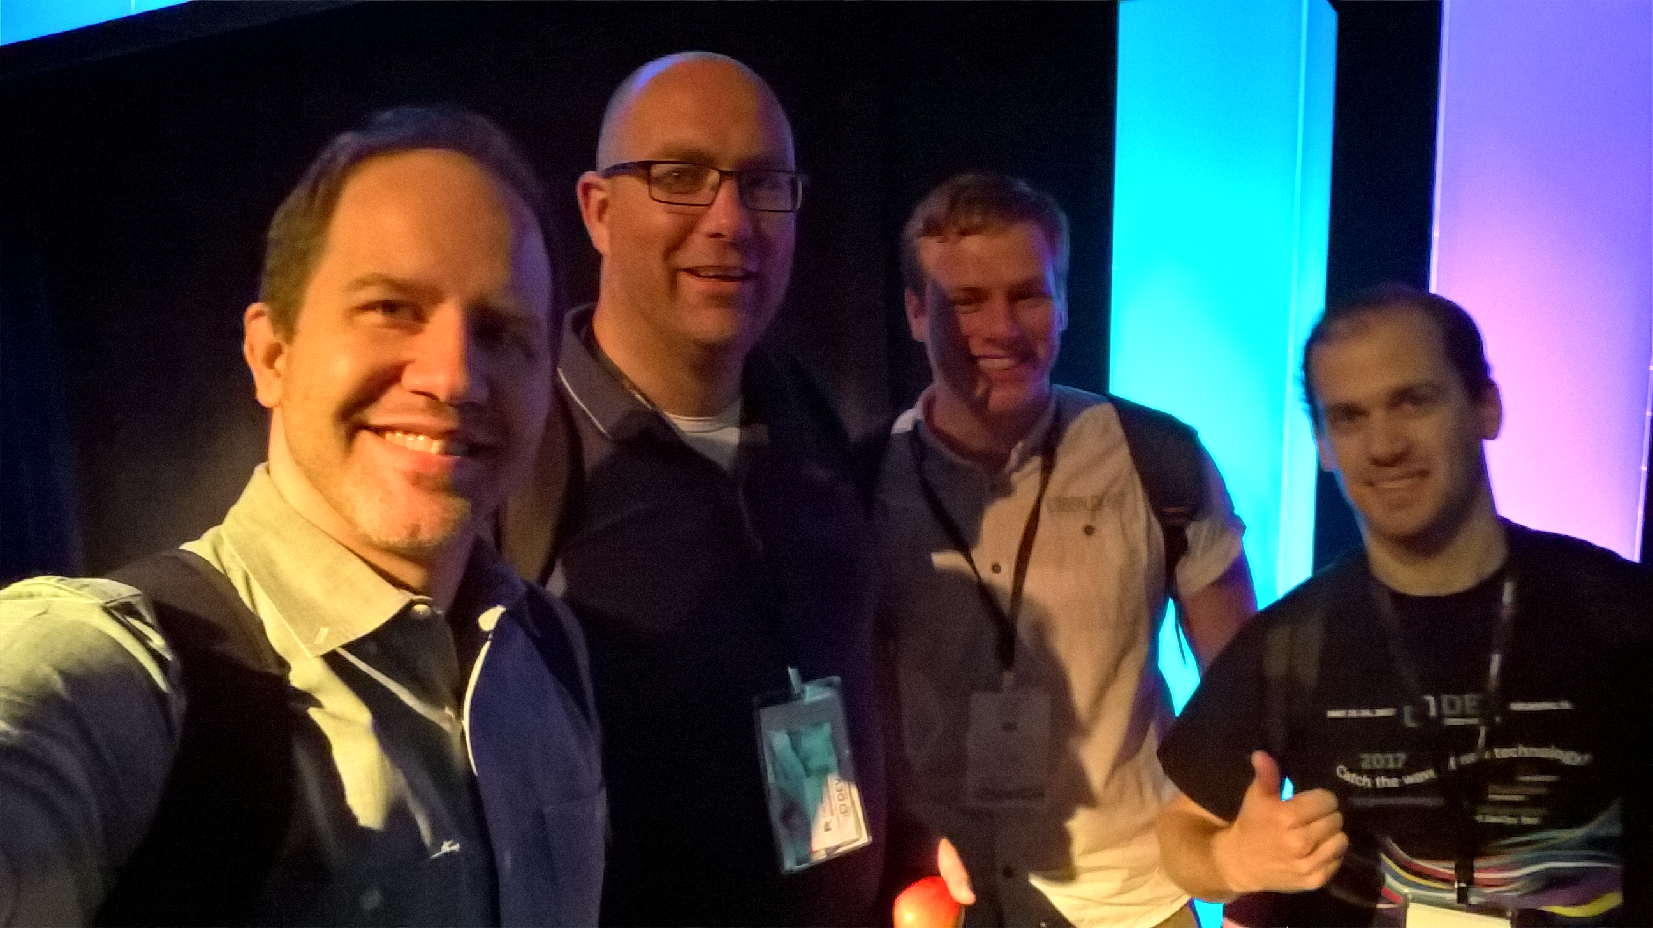
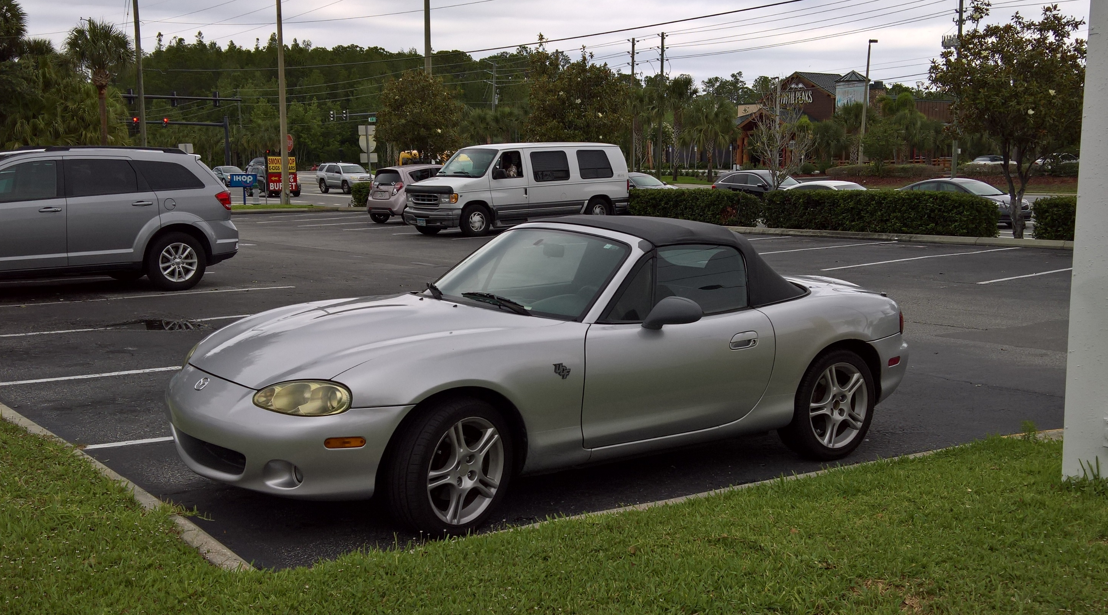


Slide 4
Agenda
.NET Standard
Portability Analyzer
Useful Azure tools
Application Map
Security Center
Log Analytics
Azure Monitor
Azure Diagnostics Demo
Debug Snapshots
Live Production Debugging

Slide 5
.NET Standard

Slide 6
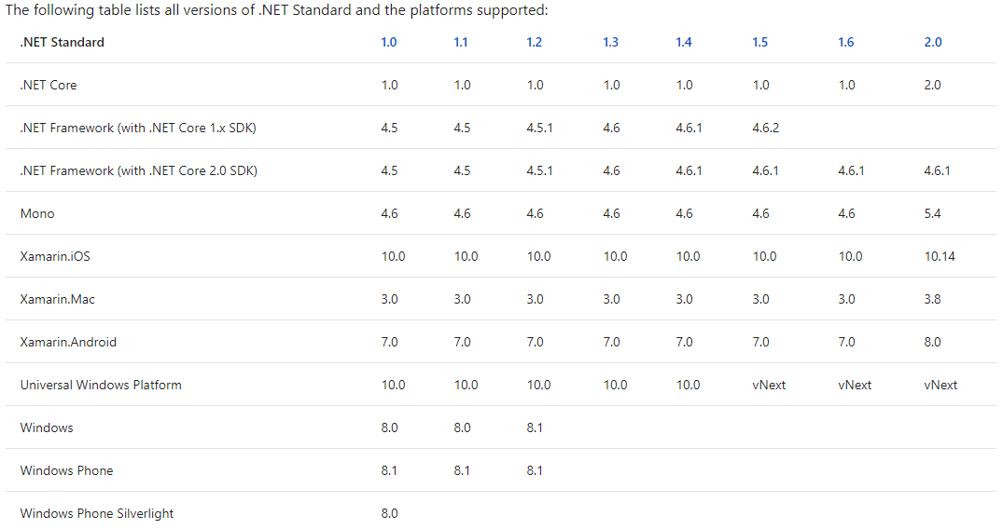
.NET Implementations

Slide 7
Portability Analyzer

Slide 8
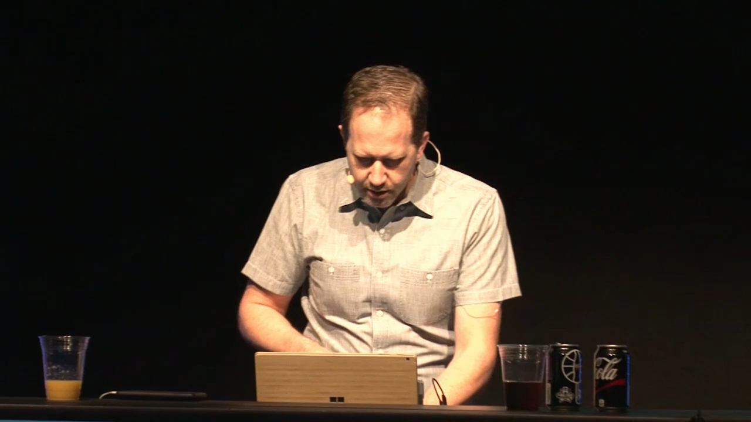

Slide 9
Portability Analyzer
Demo

Slide 10
Useful Azure Tools

Slide 11
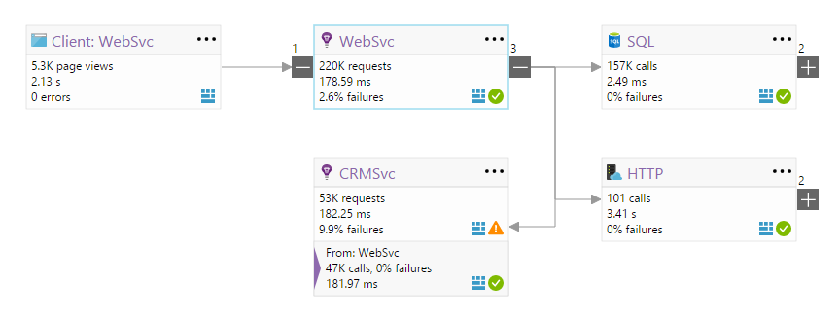
Application Map

Slide 12
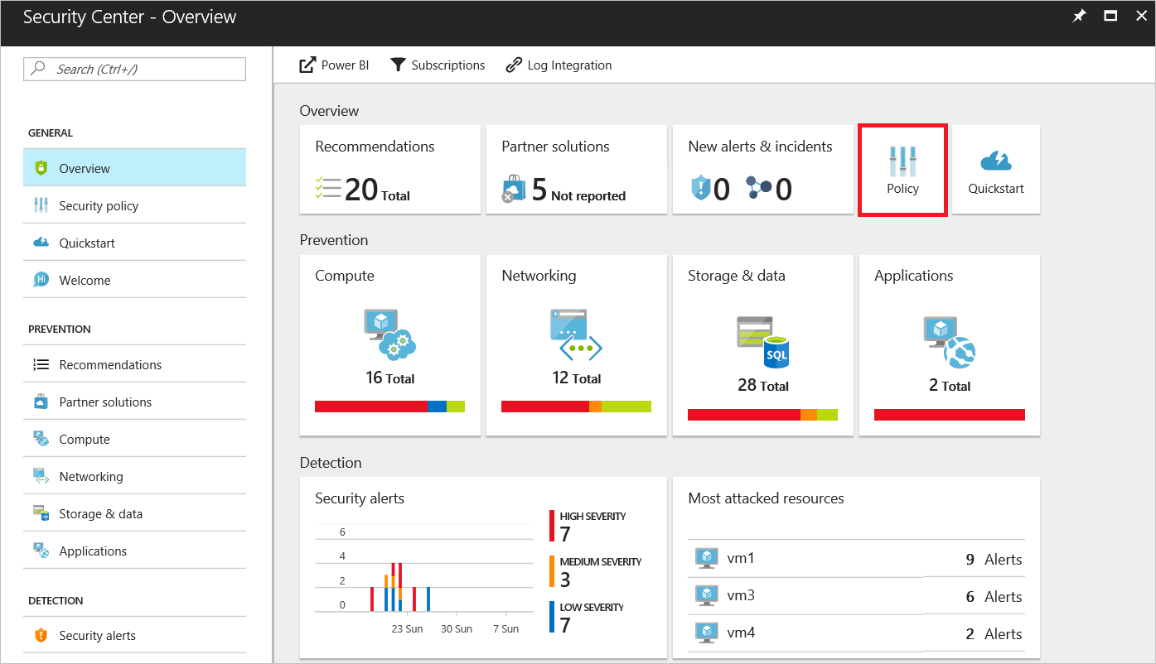
Security Center

Slide 13
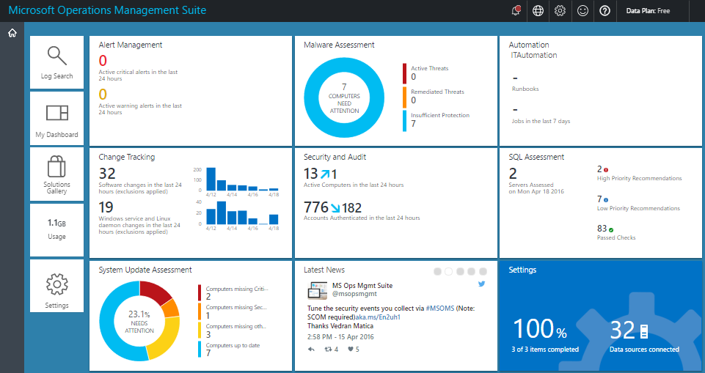
Log Analytics

Slide 14
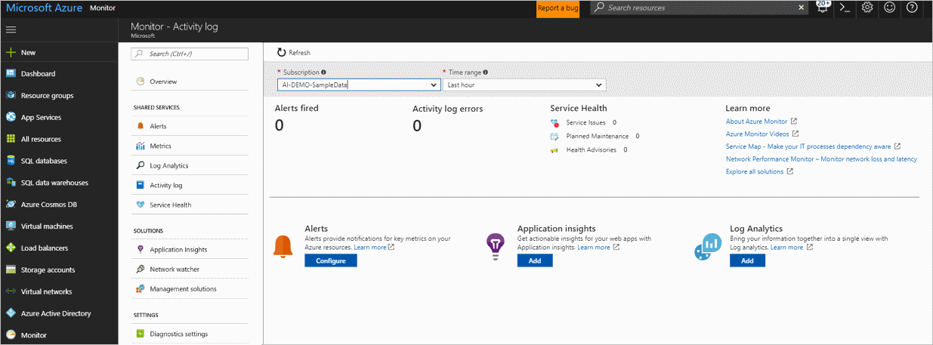
Azure Monitor

Slide 15
Azure Diagnostics Demo

